Slide 1
Exploring Register File Size in ASIP Synthesis
Presenter Manoj Kumar Jain
http://www.cse.iitd.ernet.in/~manoj
Supervisors Prof. M. Balakrishnan and Prof. Anshul Kumar
Department of Computer Science & Engineering
IIT Delhi
IRISS 2002, 28th and 29th March 2002

Slide 2
Outline
ASIP introduction
Overall Objectives
Work done on Register File Size exploration
Conclusions
Publications

Slide 3
Application Specific Instruction set Processor (ASIP)
Designed for specific application
Exploits special characteristics to meet the desired constraints
Efficient for applications like digital signal processing, automatic control systems, cellular phones

Slide 4
GPP-ASIP-ASIC
 | GPP | ASIP | ASIC
Performance | Low | High | Very High
Flexibility | Excellent | Good | Poor
HW Design Effort | Nil | Large | Very Large
SW Design Effort | Small | Large | Nil
Power | Large | Medium | Small
Reuse | Excellent | Good | Poor
Markets | Very Large | Relatively large | Small
Cost | Mainly on SW | S-O-C | Volume sensitive

Slide 5
Flow Diagram of ASIP Design Methodology
Application &
Design Constraints
Application Analysis
Architectural Design Space Exploration
Instruction Set
Generation
Code Synthesis
Hardware Synthesis
Object Code
Processor Description

Slide 6
Approaches in ASIP Design Space Exploration
Application
(C)
Retargetable
Compiler
Object
Code
Simulator
Simulator based
Architecture
Description
Trace Data
Architecture
Description
Application
(C)
Profiler
Scheduler based
Retargetable
Estimator
Performance and
other Estimates

Slide 7
Simulator based v/s Estimation based
Simulator Estimation based
Efficient retargetable compiler No assembly code
and simulator required generation
Slower Faster
More accurate Less accurate
More arch. features explored Less arch. features explored

Slide 8
Previous work on Storage Exploration
Register banks , I/D-Cache [Gloria90, Gong95, Kin99]
Attempt to optimize register count based on profiler information but method needs code generation and analysis [Honma94]
Language based approach [Mishra2001]

Slide 9
What needs to be done and overall objectives
Increasing dimensions of design space
Design space exploration needs to be very fast
Storage organization to be explored by analytical approach
Exploring Register File Size, Cache design space and other storage structures

Slide 10
Register Size Evaluation: Objectives
Study the impact of changing register file size on performance, power and energy
Analyze the observations of above study and finding relevance of exploring register file size in ASIP design
Develop an estimation based framework for quick evaluation of register file size
Implement and validate the analytical framework

Slide 11
Motivating Study: Study the imact of change in Register file size
Methodology
Parameterized compiler for ARM
Execution
Code-size, cycle, power and energy analysis
Parameter values
Decision for next parameter value

Slide 12
Experimental Setup
Benchmark
Suite
encc
Compiler
Instruction Set
Simulator
Register File
Size
Trace Data
C Code
encc
assembly
Assembler &
Linker
executable
energy
database
profiling
information
trace
analyzer
trace file
ISS

Slide 13
Results
Range Number of registers 3 to 8
Memory configurations
- only off chip
- on-chip instruction off-chip data
Results collected
- number of instructions executed
- number of cycles
- ratio of spilling instructions (static)
- power consumption
- energy consumption

Slide 14
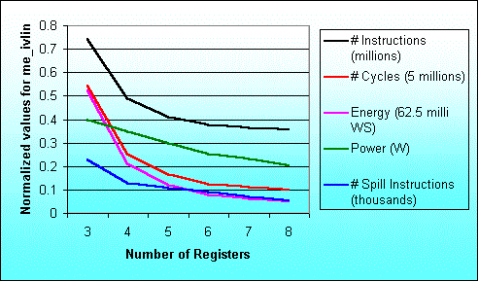
Result for the program me_ivlin
knee due to exec. time reduction
knee due to power saving

Slide 15
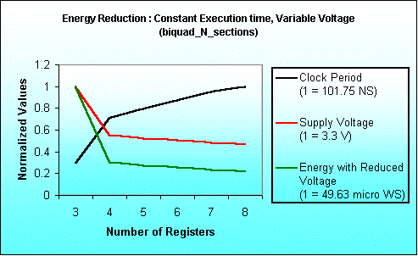
Energy Saving due to
Voltage Scaling
Notes:
Here we have assumed total execution time as constant.
To keep execution time as constant when execution requires lesser number
of cycles we have increased the clock period.
With the increased clock period we can reduce supply voltage.
For estimating supply voltage with varying clock period we had referred
The paper titled “Low Power CMOS Digital Design” – A.P Chandrakasan et al
IEEE J. Solid-State Circuits, Vol. 27, No. 4, pp. 473-484, April 1992.
With this estimated voltage we have calculated Energy.
Since Energy is product of Average Power Consumption and Execution time,
here Execution time is constant and
Power depends quadratically on Voltage.
Keeping these facts into consideration we have computed
Energy Consumption.

Slide 16
Maximum variation in results
Benchmark Program | Performance |  | Power |  | Energy
 | Reg. size | % inc. | Reg. size | % red. | Reg. size | % red.
biquad_N_sections | 3 → 4 | 57.5 | 3 → 4 | 12.6 | 3 → 4 | 62.9
lattice_init | 4 → 5 | 20.5 | 6 → 7 | 1.0 | 4 → 5 | 21.0
matrix-mult | 3 → 4 | 29.7 | 7 → 8 | 7.4 | 3 → 4 | 33.4
me_ivlin | 3 → 4 | 53.4 | 5 → 6 | 15.3 | 3 → 4 | 59.3
bubble_sort | 4 → 5 | 46.3 | 4 → 5 | 17.3 | 4 → 5 | 55.6
heap_sort | 6 → 7 | 25.6 | 6 → 7 | 10.3 | 6 → 7 | 33.2
insertion_sort | 4 → 5 | 44.8 | 4 → 5 | 22.3 | 4 → 5 | 57.1
election_sort | 3 → 4 | 22.2 | 5 → 6 | 14.0 | 5 → 6 | 30.1
Average |  | 37.5 |  | 12.5 |  | 44.1

Slide 17
Conclusion from this phase of work
Studied results for number of inst. executed cycles, spilling, power and energy consumption for ARM7TDMI processor. Similar results for LEON processor.
Range of number of registers 3 to 8.
Single increase in number of registers results in up to 57.5% performance improvement and 62.9% reduction in energy consumption.

Slide 18
Framework for fast exploration of Register File Size
Uses SUIF intermediate representation
Uses concept of Register Reuse Chain
No need of code generator
Simple processor description (mainly operation latencies)
Retargetable and fast
Implementation complete, Validation is in progress

Slide 19
Proposed Methodology for Performance Estimation
Get dependency at the basic block level
Get initial and reduced chains
Compute Costs of merging the chains
Merge the chains (use option of inserting spill instructions if situation arises)
Estimate performance with modified instructions and dependencies

Slide 20
Register Reuse Chains
A RRC contain all the variables assigned to the same register
Earliest Ultimate Killing or EUK nodes are used to construct RRCs
Basic Idea Recursively search the EUK nodes
and assign the same register.

Slide 21
Illustrative Example : Finding EUK Nodes
a
Node EUK
2 4
4 16
5 4
7 17
8 7
10 17
11 10
13 16
14 13
16 19
17 16
19 19
20 19
a=1;
b=a+2;
c=3*b;
d=b/4;
e=b-5;
f=c+d+e;
g=6*f
C Code
2
5
2
11
b
4
14
4
5
8
3
c
d
10
e
7
13
17
f
st
16
20
6
g
19
Earliest Ultimate Killing (EUK) Node is the earliest node where Variable’s live range is guaranteed to end

Slide 22
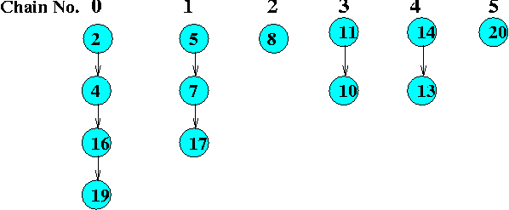
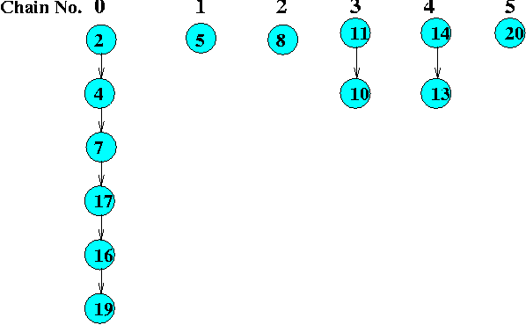
Initial and Reduced Register Reuse Chains
Initial Chains
Reduced Chains

Slide 23
Merging Costs
 | 0 | 1 | 2 | 3 | 4 | 5
0 | Nm | Nm | Nm | Nm | Nm | Nm
1 | 2 | Nm | 0 | 0 | 0 | 0
2 | 2 | 2 | Nm | 2 | 2 | 0
3 | Nm | Nm | 4 | Nm | 4 | 0
4 | Nm | Nm | 4 | 4 | Nm | 0
5 | 2 | 2 | 2 | 2 | 2 | Nm

Slide 24
Sets with cost paid and Performance Estimates with varying No. of registers
Number of Registers | Sets with costs | PE #cycles
>= 6 |  | 28
5 | {2,4}:2, {5,3}:2, {0}:0, {1}:0 | 29
4 | {2,5,3,4}:20, {0}:0, {1}:0 | 34
3 | {2,5,3,4}:20, {1,0}:2 | 35

Slide 25
Methodology : ASSIST Flow Diagram
Application
Constraints
Profiler
Parameter
Extractor
Application Parameters
Register size evaluation
Basic
Processor
Config.
Component
Power
models
Configuration
Selector
Processor
Pipeline +
models
# of clocks
Estimator
Power
Estimator
Area and
Clock Period
Estimator
Area and
Clock period
data
Processor
Configurations
Design Space Explorer
Retargetable
Compiler Generator
Synthesizable
VHDL Generator
ASIP Compiler
Synthesizable
VHDL

Slide 26
Conclusion and Status
Implementation of the register allocation and performance estimation is complete
Considers the global needs
No need of code generation for specific processor for our evaluation purpose
No need of simulator for specific configuration
Simple processor description
Initial results are in
Validation is in progress

Slide 27
Publications (Journal and Reviewed Conferences Papers
Jain, M.K.; Balakrishnan, M.; Anshul Kumar : “ASIP Design Methodologies : Survey and Issues”, VLSI 2001.
Jain, M.K.; Wehmeyer, L.; Steinke, S.; Marwedel, P.; Balakrishnan, M. : “Evaluating Register File Size in ASIP Synthesis”, CODES 2001.
Wehmeyer, L.; Jain, M.K.; Steinke, S.; Marwedel, P.; Balakrishnan, M. : “Analysis of the Influence of the Register File Size on Energy Consumption, Code Size and Execution Time”, IEEE TCAD, vol. 20, no. 11, Nov. 2001.
(First version was presented in SCOPES, March 2001)

Slide 28
Thanks

